Slide 1
Logistic Regression

Slide 2
Logistic Regression
Linear Regression overview
Introduction
Hypothesis representation
Cost function
Logistic regression with gradient descent
Regularization
Multi-class classification

Slide 3

Classification
Email: Spam / Not Spam?
Online Transactions: Fraudulent (Yes / No)?
Tumor: Malignant / Benign ?
0: “Negative Class” (e.g., benign tumor)
1: “Positive Class” (e.g., malignant tumor)

Slide 4
Logistic Regression
Regression used to fit a curve to data in which the dependent variable is binary, or dichotomous
Typical application: Medicine
dichotomous (yes/no, smoker/nonsmoker,…)
categorical (social class, race, ... )
continuous (age, weight, gestational age, ...)
dichotomous categorical response variable Y
e.g. Success/Failure, Remission/No Remission Survived/Died, Low Birth Weight/Normal Birth Weight, etc…

Slide 5
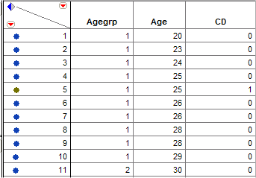
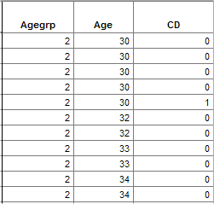

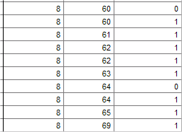
Logistic Regression
Example: Coronary Heart Disease (CD) and Age In this study sampled individuals were examined for signs of CD (present = 1 / absent = 0) and the potential relationship between this outcome and their age (yrs.) was considered.
…
This is a portion of the raw data for the 100 subjects who participated in the study.

Slide 6
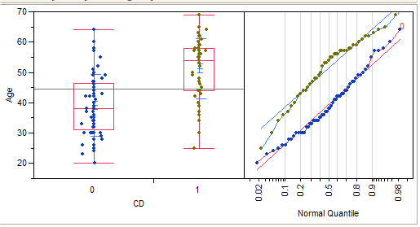
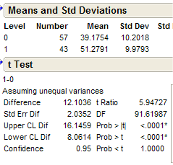
Logistic Regression
How can we analyze these data?
Non-pooled t-test
The mean age of the individuals with some signs of coronary heart disease is 51.28 years vs. 39.18 years for individuals without signs (t = 5.95, p < .0001).

Slide 7


1 (Yes)
Malignant?
Threshold classifier output $h_{θ}\left(x\right)$ at 0.5
If $h_{θ}\left(x\right)≥0.5,$ predict “$y=1$”
If $h_{θ}\left(x\right)<0.5$, predict “$y=0$”
0 (No)
Tumor Size
$$h_{θ}\left(x\right)=θ^{⊤}x$$

Slide 8
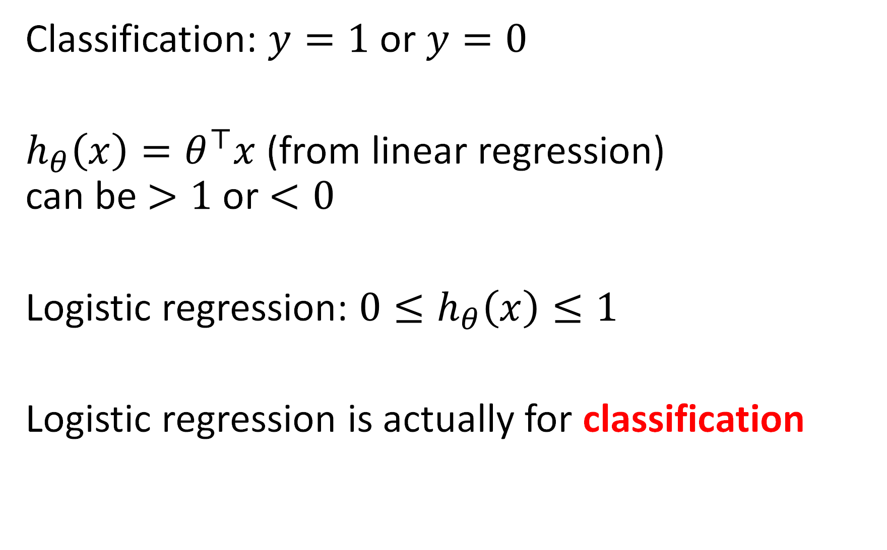
Classification: $y=1$ or $y=0$
$h_{θ}\left(x\right)=θ^{⊤}x$ (from linear regression) can be $>1$ or $<0$
Logistic regression: ${0≤h}_{θ}\left(x\right)≤1$
Logistic regression is actually for classification

Slide 9
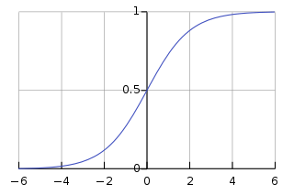

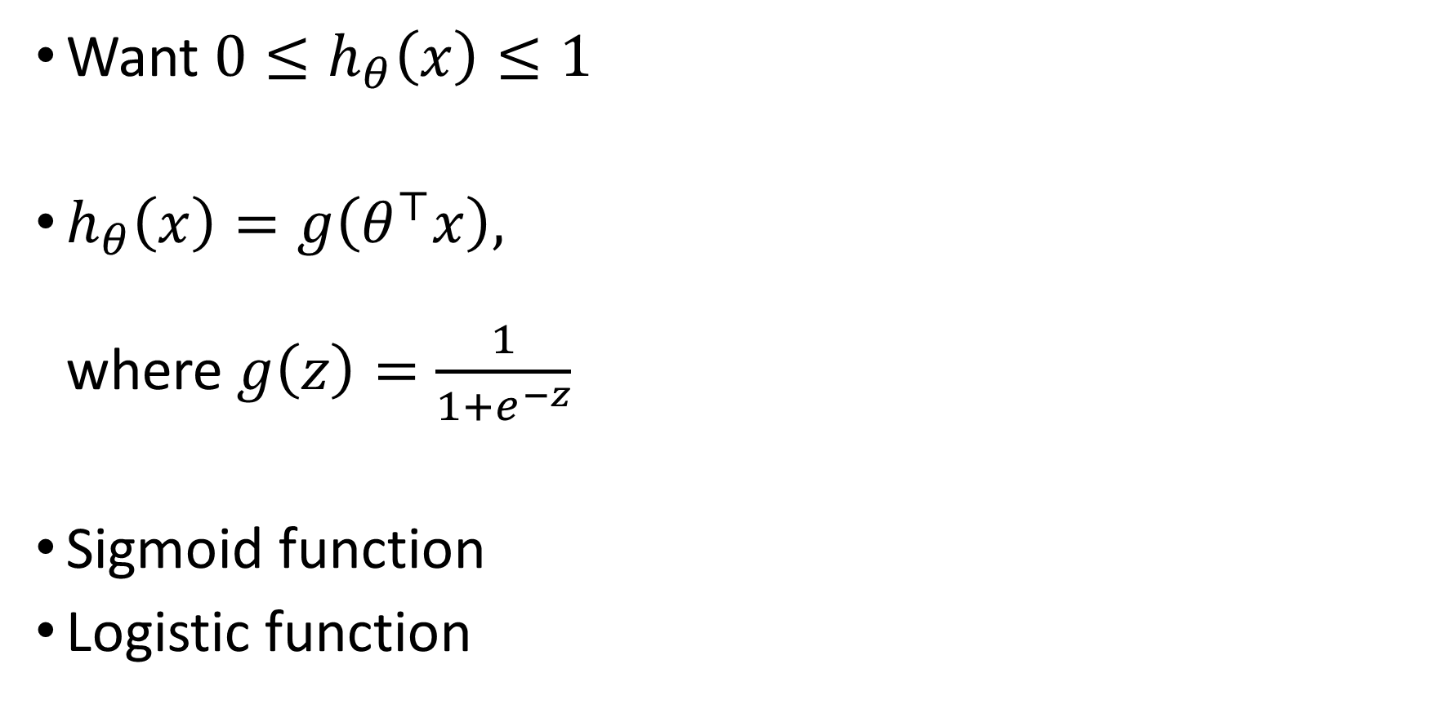


Hypothesis representation
Want ${0≤h}_{θ}\left(x\right)≤1$
$h_{θ}\left(x\right)=g\left(θ^{⊤}x\right),$ where $g\left(z\right)=\frac{1}{1+e^{−z}}$
Sigmoid function
Logistic function
$$h_{θ}\left(x\right)=\frac{1}{1+e^{−θ^{⊤}x}}$$
$$g(z)$$
$$z$$

Slide 10


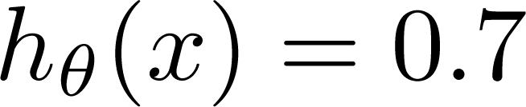
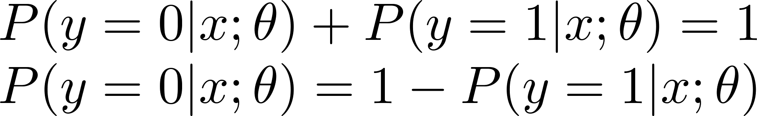
Interpretation of Hypothesis Output
= estimated probability that y = 1 on input x
Example: If
Tell patient that 70% chance of tumor being malignant
“probability that y = 1, given x,
parameterized by ”

Slide 11
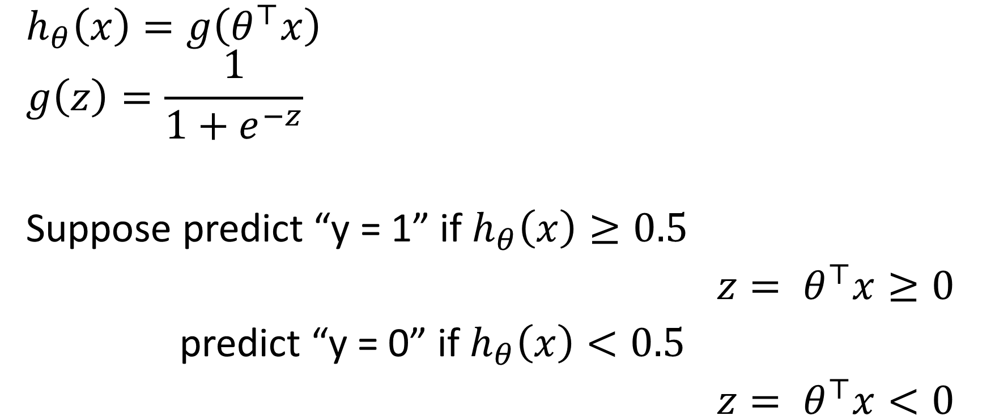


Logistic regression
$$g(z)$$
$$h_{θ}\left(x\right)=g\left(θ^{⊤}x\right)$$
$$g\left(z\right)=\frac{1}{1+e^{−z}}$$
Suppose predict “y = 1” if $h_{θ}\left(x\right)≥0.5$
$${z= θ}^{⊤}x≥0$$
predict “y = 0” if $h_{θ}\left(x\right)<0.5$
$${z= θ}^{⊤}x<0$$
$$z=θ^{⊤}x$$

Slide 12
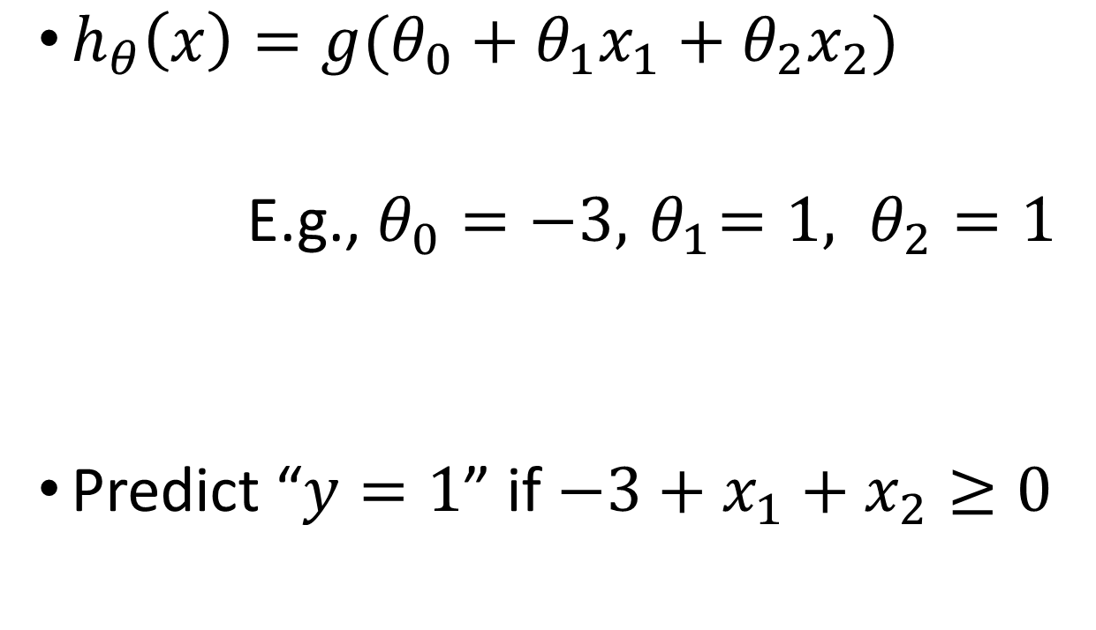
Decision boundary
How to fit (find) Parameter θ Parameter θ (θ₀, θ₁, θ₂) defines the decision boundary not the training set. Training set may be used to find the Parameter θ
$h_{θ}\left(x\right)=g(θ_{0}+θ_{1}x_{1}+θ_{2}x_{2})$
E.g., $θ_{0}=−3, { θ}_{1}=1, θ_{2}=1$
Predict “$y=1$” if $−3+x_{1}+x_{2}≥0$
Age
Tumor Size

Slide 13
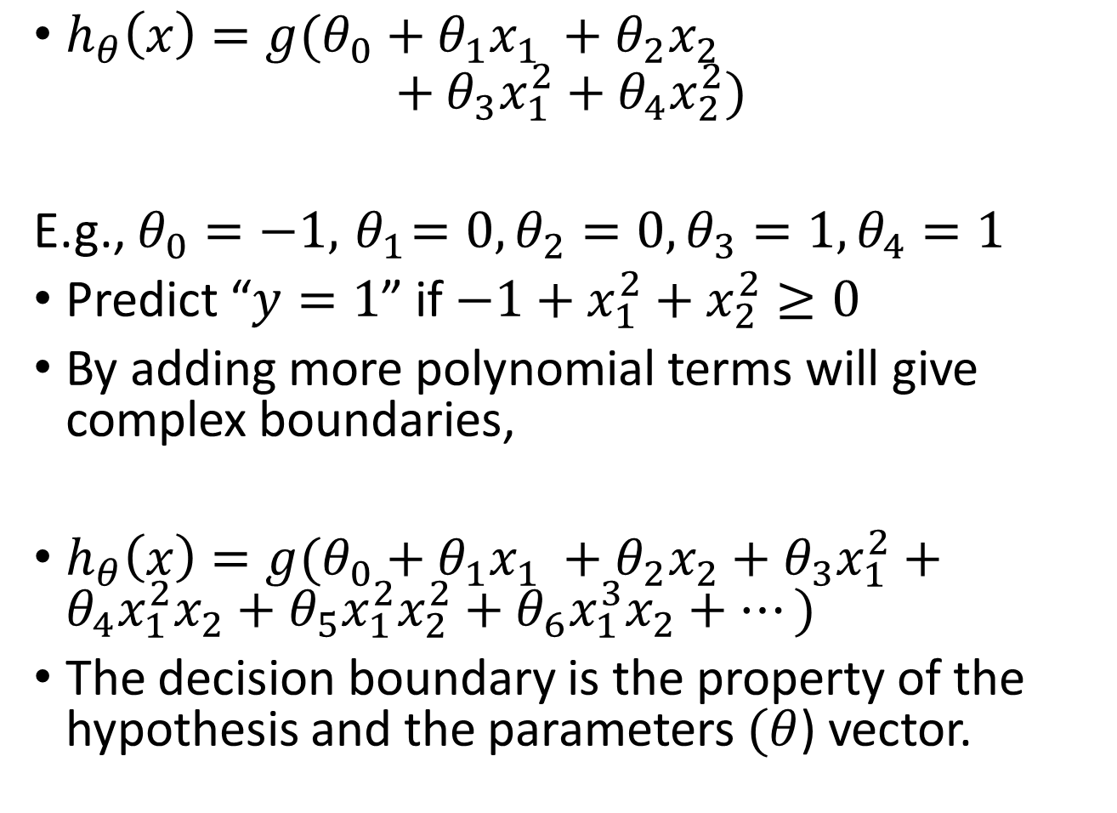
$h_{θ}\left(x\right)=g(θ_{0}+θ_{1}x_{1} +θ_{2}x_{2}$ $+θ_{3}x_{1}^{2}+θ_{4}x_{2}^{2})$
E.g., $θ_{0}=−1, { θ}_{1}=0, θ_{2}=0,θ_{3}=1, θ_{4}=1$
Predict “$y=1$” if $−1+x_{1}^{2}+x_{2}^{2}≥0$
By adding more polynomial terms will give complex boundaries,
$h_{θ}\left(x\right)=g(θ_{0}+θ_{1}x_{1} +θ_{2}x_{2}+θ_{3}x_{1}^{2}+θ_{4}x_{1}^{2}x_{2}+θ_{5}x_{1}^{2}x_{2}^{2}+θ_{6}x_{1}^{3}x_{2}+⋯)$
The decision boundary is the property of the hypothesis and the parameters $(θ$) vector.

Slide 14
Logistic Regression
Hypothesis representation
Cost function
Logistic regression with gradient descent
Regularization
Multi-class classification

Slide 15
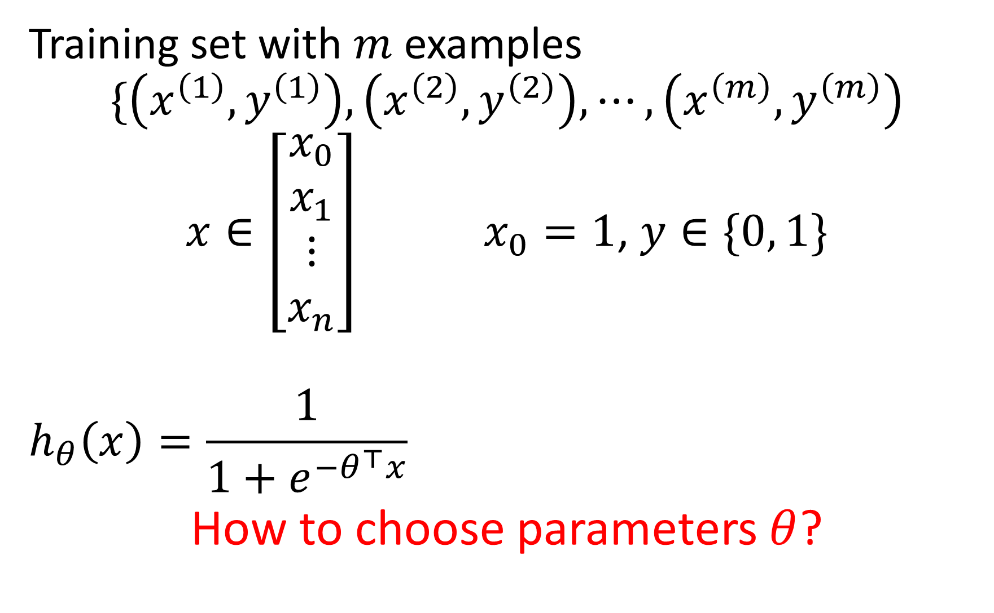
Training set with $m$ examples
$$\{\left(x^{\left(1\right)}, y^{\left(1\right)}\right), \left(x^{\left(2\right)}, y^{\left(2\right)}\right), ⋯,\left(x^{\left(m\right)}, y^{\left(m\right)}\right)$$
$x∈\left[\begin{aligned}x_{0} \\ x_{1} \\ ⋮ \\ x_{n}\end{aligned}\right]x_{0}=1$, $y∈\{0, 1\}$
$$h_{θ}\left(x\right)=\frac{1}{1+e^{−θ^{⊤}x}}$$
How to choose parameters $θ$?

Slide 16
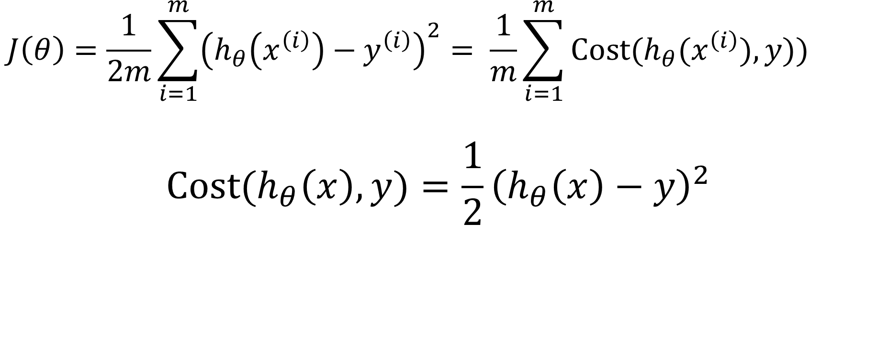
Cost function for Linear Regression
$$J\left(θ\right)=\frac{1}{2m}\sum_{i=1}^{m}{{\left(h_{θ}\left(x^{\left(i\right)}\right)−y^{\left(i\right)}\right)}^{2}}= \frac{1}{m}\sum_{i=1}^{m}{Cost(h_{θ}(x^{\left(i\right)}),y))}$$
$$Cost(h_{θ}\left(x\right),y)=\frac{1}{2}{\left(h_{θ}\left(x\right)−y\right)}^{2}$$

Slide 17
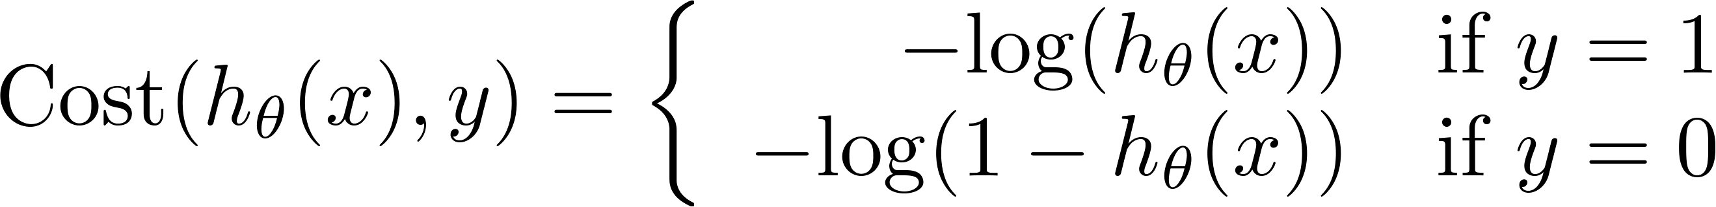
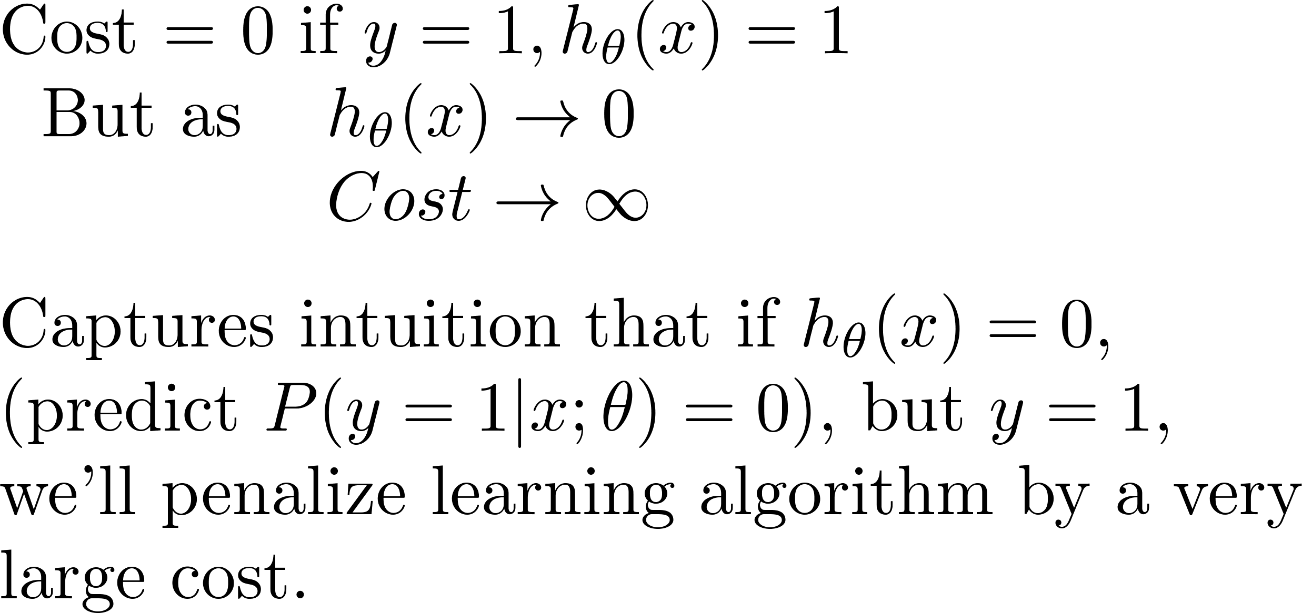

Logistic regression cost function
Different
Cost Function
If y = 1
0
1

Slide 18



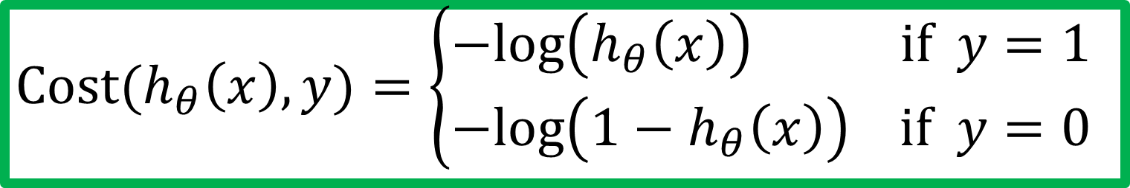





Cost function for Logistic Regression
$$Cost(h_{θ}\left(x\right),y)=\left\{\begin{aligned}−log\left(h_{θ}\left(x\right)\right) if y=1 \\ −log\left({1−h}_{θ}\left(x\right)\right) if y=0\end{aligned}\right.$$
$$if y=1$$
$$if y=0$$
$$0$$
$$h_{θ}\left(x\right)$$
$$1$$
$$0$$
$$h_{θ}\left(x\right)$$
$$1$$

Slide 19
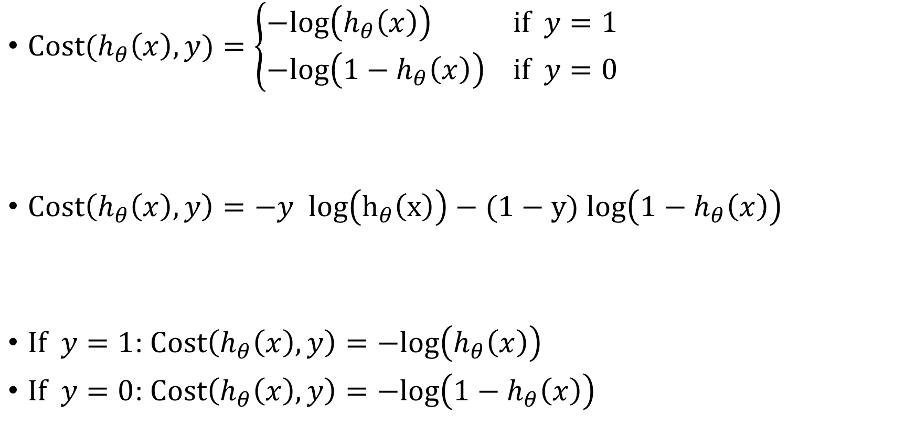
Logistic regression cost function
$Cost(h_{θ}\left(x\right),y)=\left\{\begin{aligned}−log\left(h_{θ}\left(x\right)\right) if y=1 \\ −log\left({1−h}_{θ}\left(x\right)\right) if y=0\end{aligned}\right.$
$Cost\left(h_{θ}\left(x\right),y\right)=−y log\left(h_{θ}\left(x\right)\right)−(1−y)log\left({1−h}_{θ}\left(x\right)\right)$
$If y=1$: $Cost\left(h_{θ}\left(x\right),y\right)=−log\left(h_{θ}\left(x\right)\right)$
$If y=0$: $Cost\left(h_{θ}\left(x\right),y\right)=−log\left({1−h}_{θ}\left(x\right)\right)$

Slide 20
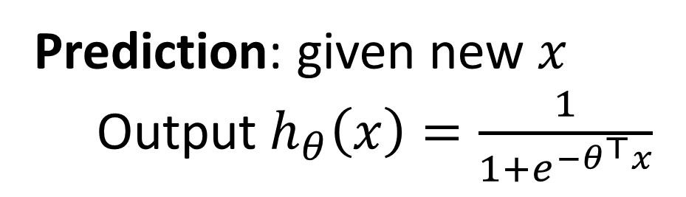

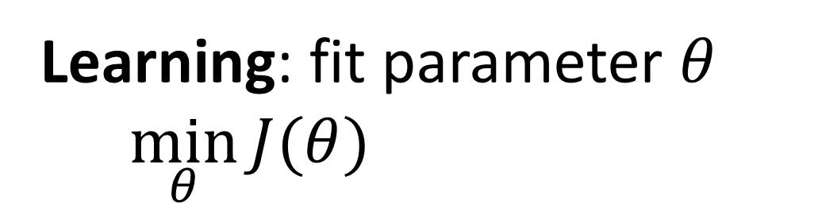
Logistic regression
$$J\left(θ\right)=\frac{1}{m}\sum_{i=1}^{m}{Cost(h_{θ}(x^{\left(i\right)}),y^{(i)}))}$$
$$=−\frac{1}{m}\left[\sum_{i=1}^{m}{y^{(i)} log\left(h_{θ}\left(x^{(i)}\right)\right)+(1−y^{(i)}) log\left({1−h}_{θ}\left(x^{(i)}\right)\right)}\right]$$
Learning: fit parameter $θ$
$$\min_{θ}{J(θ)}$$
Prediction: given new $x$
Output $h_{θ}\left(x\right)=\frac{1}{1+e^{−θ^{⊤}x}}$

Slide 21
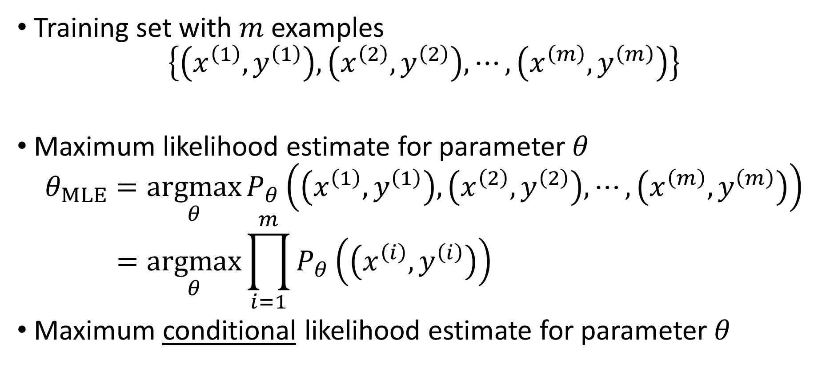
Where does the cost come from?
Training set with $m$ examples
$$\left\{\left(x^{\left(1\right)}, y^{\left(1\right)}\right), \left(x^{\left(2\right)}, y^{\left(2\right)}\right), ⋯,\left(x^{\left(m\right)}, y^{\left(m\right)}\right)\right\}$$
Maximum likelihood estimate for parameter $θ$
$$θ_{MLE}=\underset{θ}{argmax}{P_{θ}\left(\left(x^{\left(1\right)}, y^{\left(1\right)}\right), \left(x^{\left(2\right)}, y^{\left(2\right)}\right), ⋯,\left(x^{\left(m\right)}, y^{\left(m\right)}\right)\right)} \\ =\underset{θ}{argmax}{\prod_{i=1}^{m}{P_{θ}\left(\left(x^{\left(i\right)}, y^{\left(i\right)}\right)\right)}}$$
Maximum conditional likelihood estimate for parameter $θ$

Slide 22

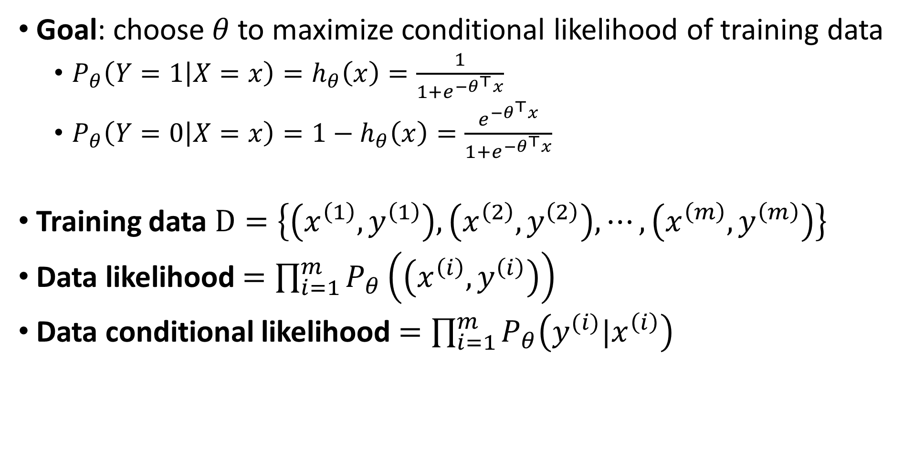
Goal: choose $θ$to maximize conditional likelihood of training data
$P_{θ}\left(Y=1 | X=x\right)=h_{θ}\left(x\right)=\frac{1}{1+e^{{−θ}^{⊤}x}}$
$P_{θ}\left(Y=0 | X=x\right)=1−h_{θ}\left(x\right)=\frac{e^{{−θ}^{⊤}x}}{1+e^{{−θ}^{⊤}x}}$
Training data $D=\left\{\left(x^{\left(1\right)}, y^{\left(1\right)}\right), \left(x^{\left(2\right)}, y^{\left(2\right)}\right), ⋯,\left(x^{\left(m\right)}, y^{\left(m\right)}\right)\right\}$
Data likelihood $=\prod_{i=1}^{m}{P_{θ}\left(\left(x^{\left(i\right)}, y^{\left(i\right)}\right)\right)}$
Data conditional likelihood $=\prod_{i=1}^{m}{P_{θ}\left(y^{(i)}|x^{\left(i\right)}\right)}$
$$θ_{MCLE}=\underset{θ}{argmax}\prod_{i=1}^{m}{P_{θ}\left(y^{(i)}|x^{\left(i\right)}\right)}$$

Slide 23
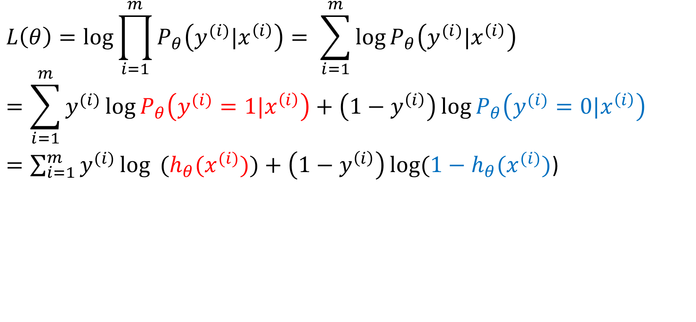
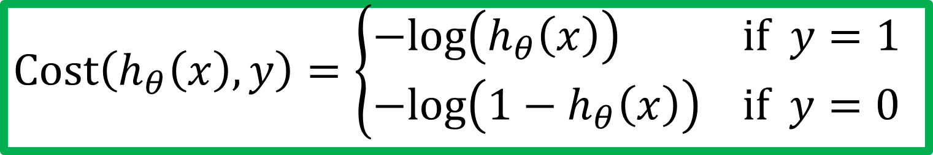
Expressing conditional log-likelihood
$$L\left(θ\right)=\log{\prod_{i=1}^{m}{P_{θ}\left(y^{(i)}|x^{\left(i\right)}\right)}}= \sum_{i=1}^{m}{\log{P_{θ}\left(y^{(i)}|x^{\left(i\right)}\right)}}$$
$$=\sum_{i=1}^{m}{y^{(i)}\log{P_{θ}\left(y^{(i)}=1|x^{\left(i\right)}\right)}}+\left(1−y^{\left(i\right)}\right)\log{P_{θ}\left(y^{(i)}=0|x^{\left(i\right)}\right)}$$
$=\sum_{i=1}^{m}{y^{(i)}\log{ (h_{θ}(x^{(i)})})}+\left(1−y^{\left(i\right)}\right)\log{(1−h_{θ}(x^{(i)})}$)
$$Cost\left(h_{θ}\left(x\right),y\right)=\left\{\begin{aligned}−log\left(h_{θ}\left(x\right)\right) if y=1 \\ −log\left({1−h}_{θ}\left(x\right)\right) if y=0\end{aligned}\right.$$

Slide 24
Logistic Regression
Hypothesis representation
Cost function
Logistic regression with gradient descent
Regularization
Multi-class classification

Slide 25
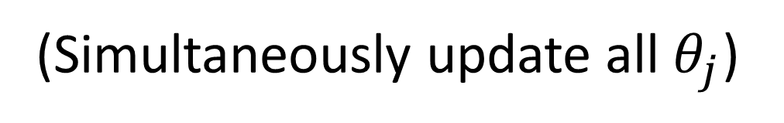

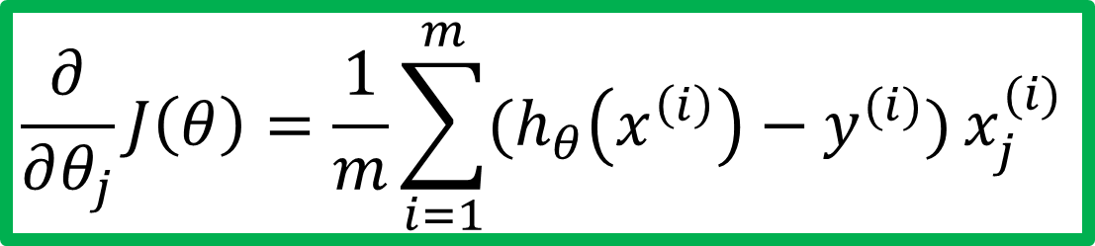
Gradient descent
$$J\left(θ\right)=−\frac{1}{m}\left[\sum_{i=1}^{m}{y^{(i)} log\left(h_{θ}\left(x^{(i)}\right)\right)+(1−y^{(i)}) log\left({1−h}_{θ}\left(x^{(i)}\right)\right)}\right]$$
Goal: $\min_{θ}{J(θ)}$
Repeat {
$$θ_{j}≔θ_{j}−α\frac{∂}{∂θ_{j}}J(θ)$$
}
Good news: Convex function!
Bad news: No analytical solution
(Simultaneously update all $θ_{j}$)
$$\frac{∂}{∂θ_{j}}J\left(θ\right)=\frac{1}{m}\sum_{i=1}^{m}{(h_{θ}\left(x^{\left(i\right)}\right)−y^{(i)})}x_{j}^{(i)}$$

Slide 26
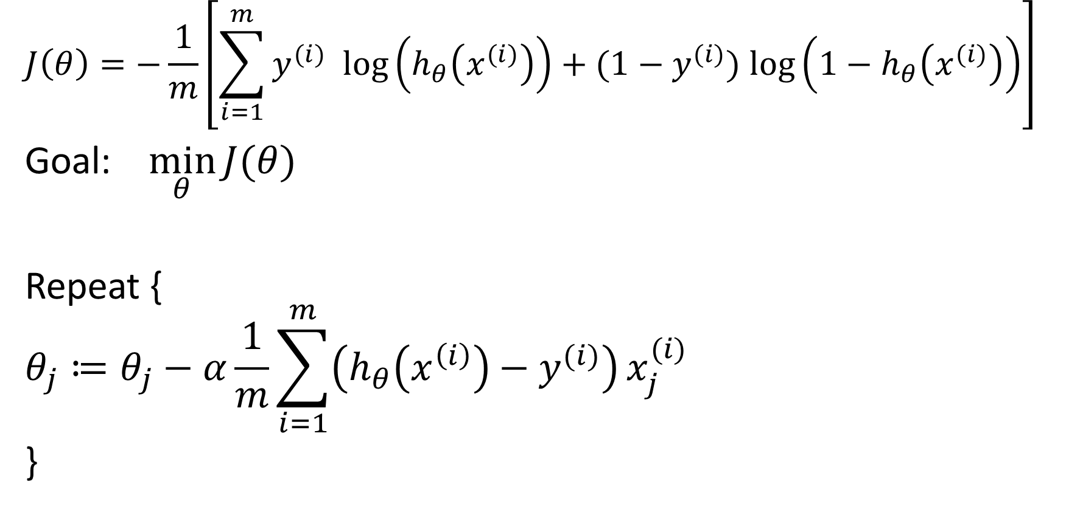
Gradient descent
$$J\left(θ\right)=−\frac{1}{m}\left[\sum_{i=1}^{m}{y^{(i)} log\left(h_{θ}\left(x^{(i)}\right)\right)+(1−y^{(i)}) log\left({1−h}_{θ}\left(x^{(i)}\right)\right)}\right]$$
Goal: $\min_{θ}{J(θ)}$
Repeat {
$$θ_{j}≔θ_{j}−α\frac{1}{m}\sum_{i=1}^{m}{\left(h_{θ}\left(x^{\left(i\right)}\right)−y^{(i)}\right)}x_{j}^{(i)}$$
}
(Simultaneously update all $θ_{j}$)

Slide 27
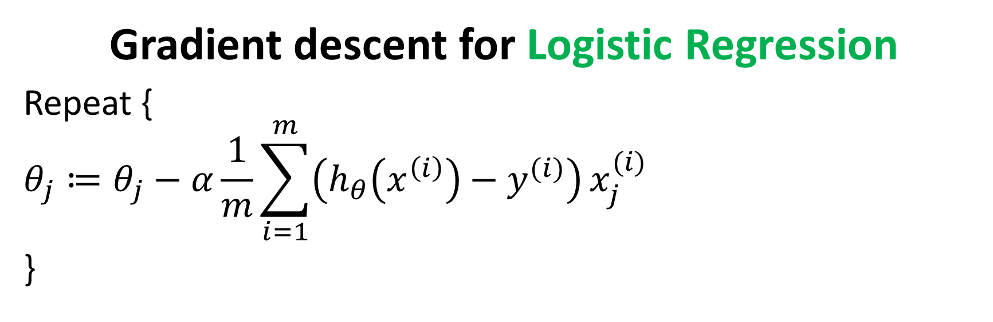
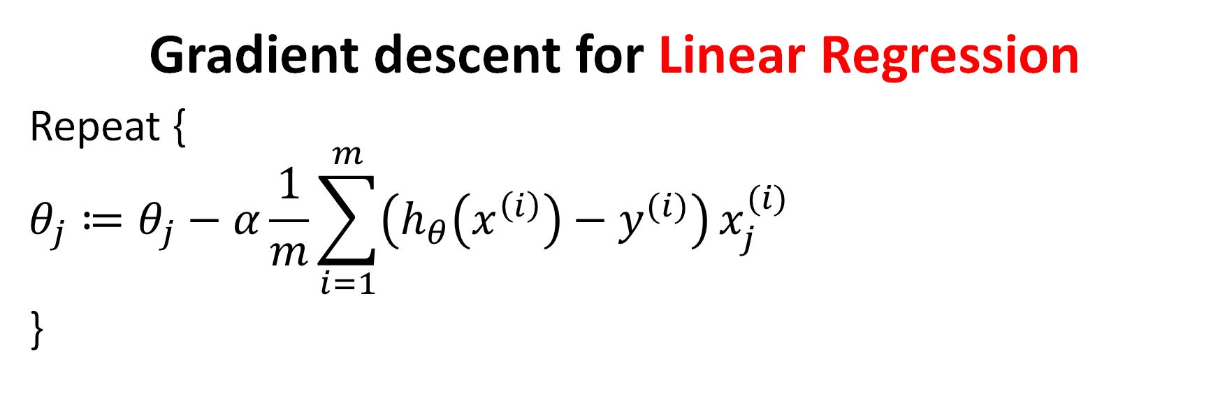


Gradient descent for Linear Regression
Repeat {
$$θ_{j}≔θ_{j}−α\frac{1}{m}\sum_{i=1}^{m}{\left(h_{θ}\left(x^{\left(i\right)}\right)−y^{(i)}\right)}x_{j}^{(i)}$$
}
$$h_{θ}\left(x\right)=θ^{⊤}x$$
Gradient descent for Logistic Regression
Repeat {
$$θ_{j}≔θ_{j}−α\frac{1}{m}\sum_{i=1}^{m}{\left(h_{θ}\left(x^{\left(i\right)}\right)−y^{(i)}\right)}x_{j}^{(i)}$$
}
$$h_{θ}\left(x\right)=\frac{1}{1+e^{−θ^{⊤}x}}$$

Slide 28
Logistic Regression
Hypothesis representation
Cost function
Logistic regression with gradient descent
Multi-class classification
Regularization

Slide 29
Multi-class classification
Email foldering / taggning: Work, Friends, Family, Hobby
Medical diagrams: Not ill, Cold, Flu
Weather: Sunny, Cloudy, Rain, Snow

Slide 30




Binary classification
Multiclass classification
$$x_{2}$$
$$x_{2}$$
$$x_{1}$$
$$x_{1}$$

Slide 31










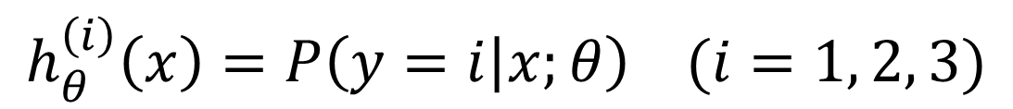

One-vs-all (one-vs-rest)
$$x_{2}$$
$$h_{θ}^{\left(1\right)}\left(x\right)$$
$$x_{1}$$
$$x_{2}$$
$$x_{2}$$
$$h_{θ}^{\left(2\right)}\left(x\right)$$
$$x_{1}$$
$$x_{1}$$
Class 1:
Class 2:
Class 3:
$$h_{θ}^{\left(3\right)}\left(x\right)$$
$$x_{2}$$
$$h_{θ}^{\left(i\right)}\left(x\right)=P\left(y=i | x;θ\right) (i=1, 2, 3)$$
$$x_{1}$$

Slide 32
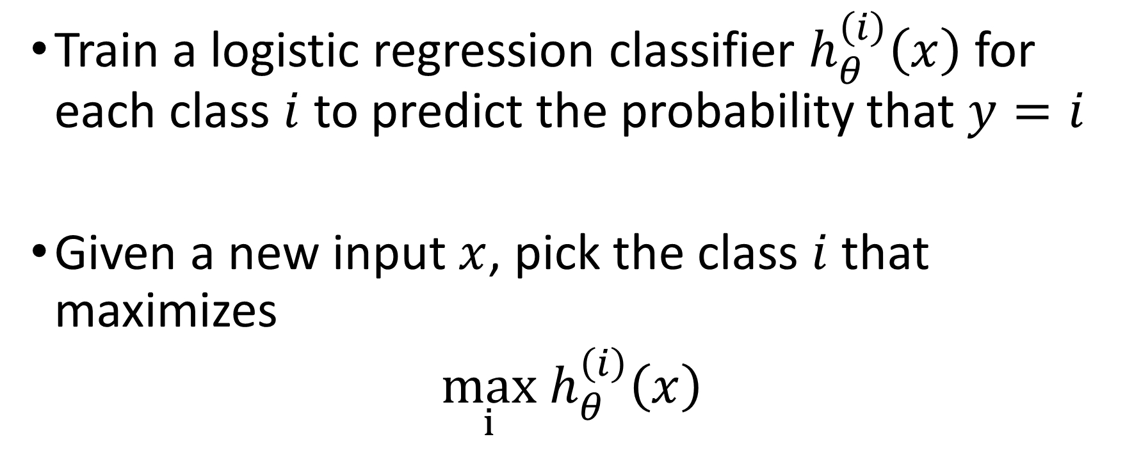
One-vs-all
Train a logistic regression classifier $h_{θ}^{\left(i\right)}\left(x\right)$ for each class $i$ to predict the probability that $y=i$
Given a new input $x$, pick the class $i$that maximizes
$$\max_{i}h_{θ}^{\left(i\right)}\left(x\right)$$

Slide 33
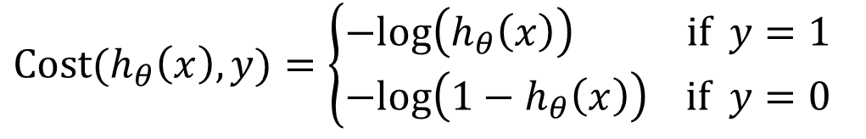
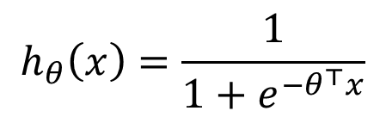
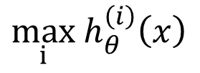
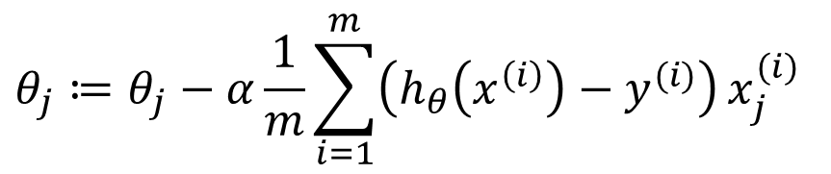
Things to remember
$$h_{θ}\left(x\right)=\frac{1}{1+e^{−θ^{⊤}x}}$$
Hypothesis representation
Cost function
Logistic regression with gradient descent
Multi-class classification
$$Cost(h_{θ}\left(x\right),y)=\left\{\begin{aligned}−log\left(h_{θ}\left(x\right)\right) if y=1 \\ −log\left({1−h}_{θ}\left(x\right)\right) if y=0\end{aligned}\right.$$
$$θ_{j}≔θ_{j}−α\frac{1}{m}\sum_{i=1}^{m}{\left(h_{θ}\left(x^{\left(i\right)}\right)−y^{(i)}\right)}x_{j}^{(i)}$$
$$\max_{i}h_{θ}^{\left(i\right)}\left(x\right)$$

